Slide 1
Approaching HANA Modeling

Slide 2
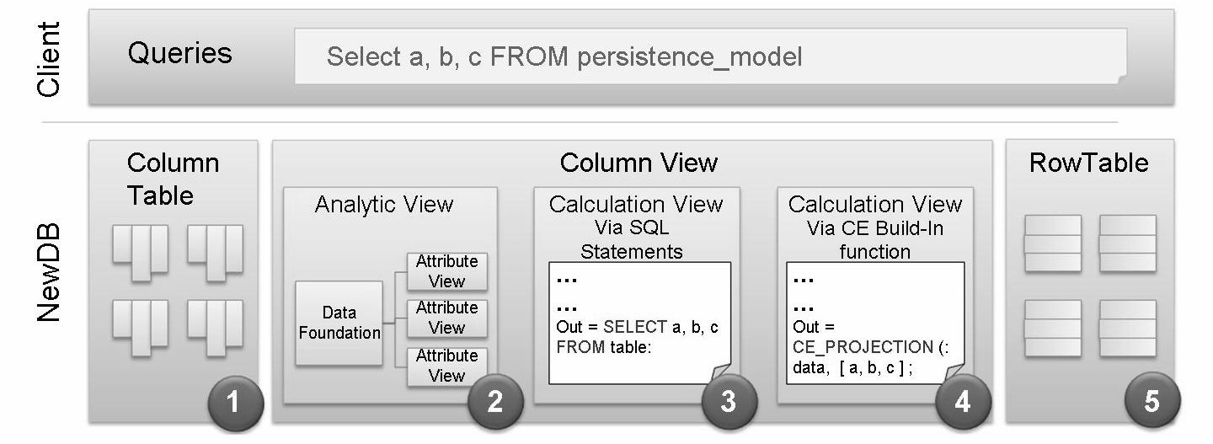
Persistency Considerations
Different scenarios have different requirements and for that also different persistency models

Slide 3
Checklist
Write or read intensive scenarios
Criteria for storage type
– for write-Intensive scenarios the recommendation is to use the row storage
– for read-intensive scenarios the recommendation is to use the column storage
Real-time Data access
Depending on the scenario requirements, various data replication tools are available. The tools can differ from each other by:
– support of table type, data type
– capability of data type transformation
Authorization
HANA data content authorization/privilege applies to specific models only
(e.g. Analytic View, Calculation View, Attribute View)
Application / Client
Different clients consume HANA DB differently and might require client specific models, some examples:
– Explorer does not support filters in the queries on design time
– Currently only AAO (Advanced Analysis for Office ) and Excel plan to support hierarchies
– WEBI always retrieves and caches the max result set
– Only Explorer, Excel and AAO do currently consume additional meta data, e.g. for multi language support
Functionality
Some complex algorithm can only expressed in L language
HANA Currency Conversion supported only via Analytic / Calculation View
UNION only in Calculation View

Slide 4
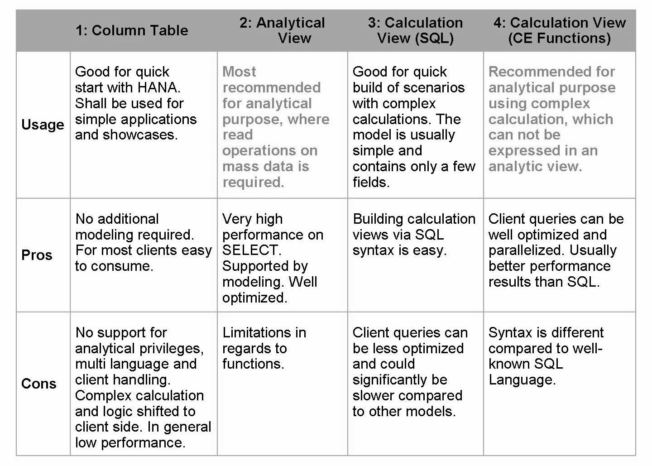
Performance

Slide 5
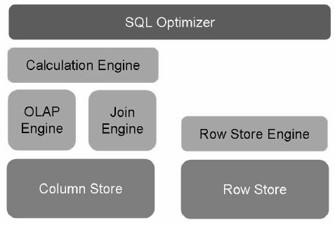
SAP HANA Engine Overview
The SAP HANA architecture provides different types of engines:
Join Engine
The Join Engine used to perform all type of joins.
OLAP Engine
The OLAP Engine is used for calculation and aggregation based on star schema or similar.
Calculation Engine
The Calculation Engine is used on top of OLAP engine and/or Join Engine for complex calculation which cannot be done by Join Engine or OLAP Engine.
The SQL Optimizer decides the best way to call the engines depending on the involved models and queries.

Slide 6
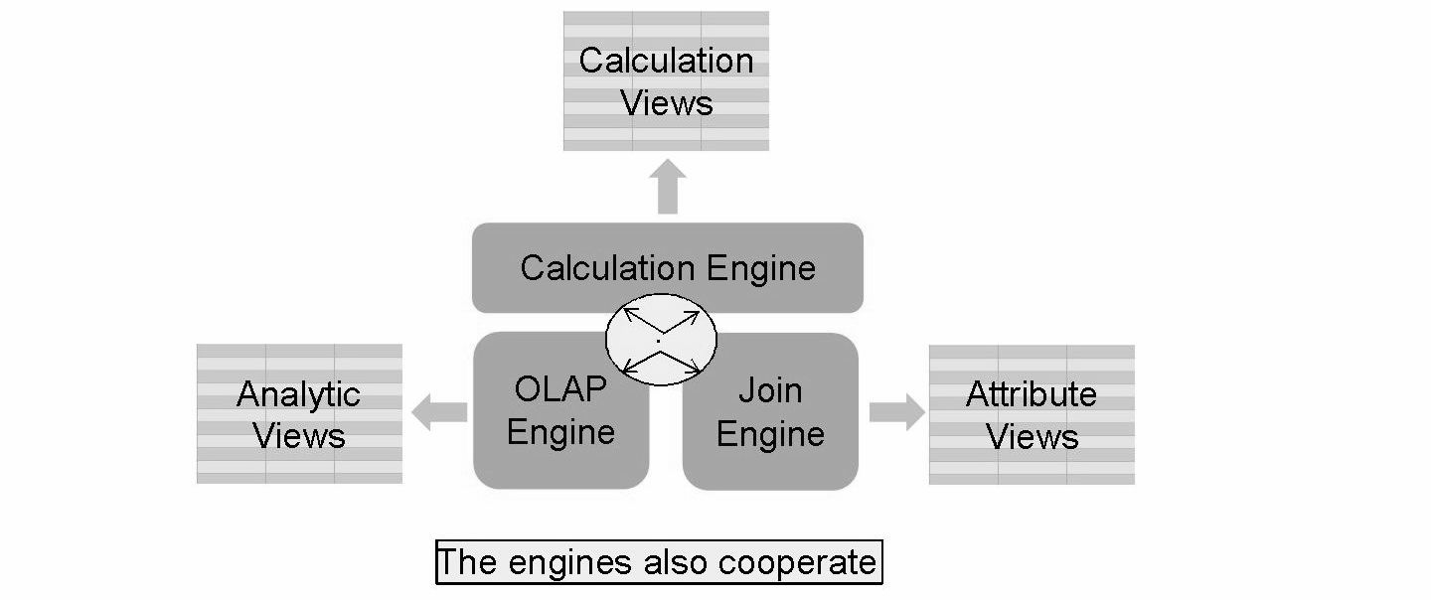
When building new Information Models, we need to keep in mind which engine is utilized.
Analytical View + Calculated Column
OR = Calculation View
Attribute View + Calculated Column
This is very important to be taken in consideration during the modeling, because it can have a big impact regarding the performances of the data model.
In general this kind of approach creating Calculated Column into Analytic View or Attribute view must be avoided.

Slide 7
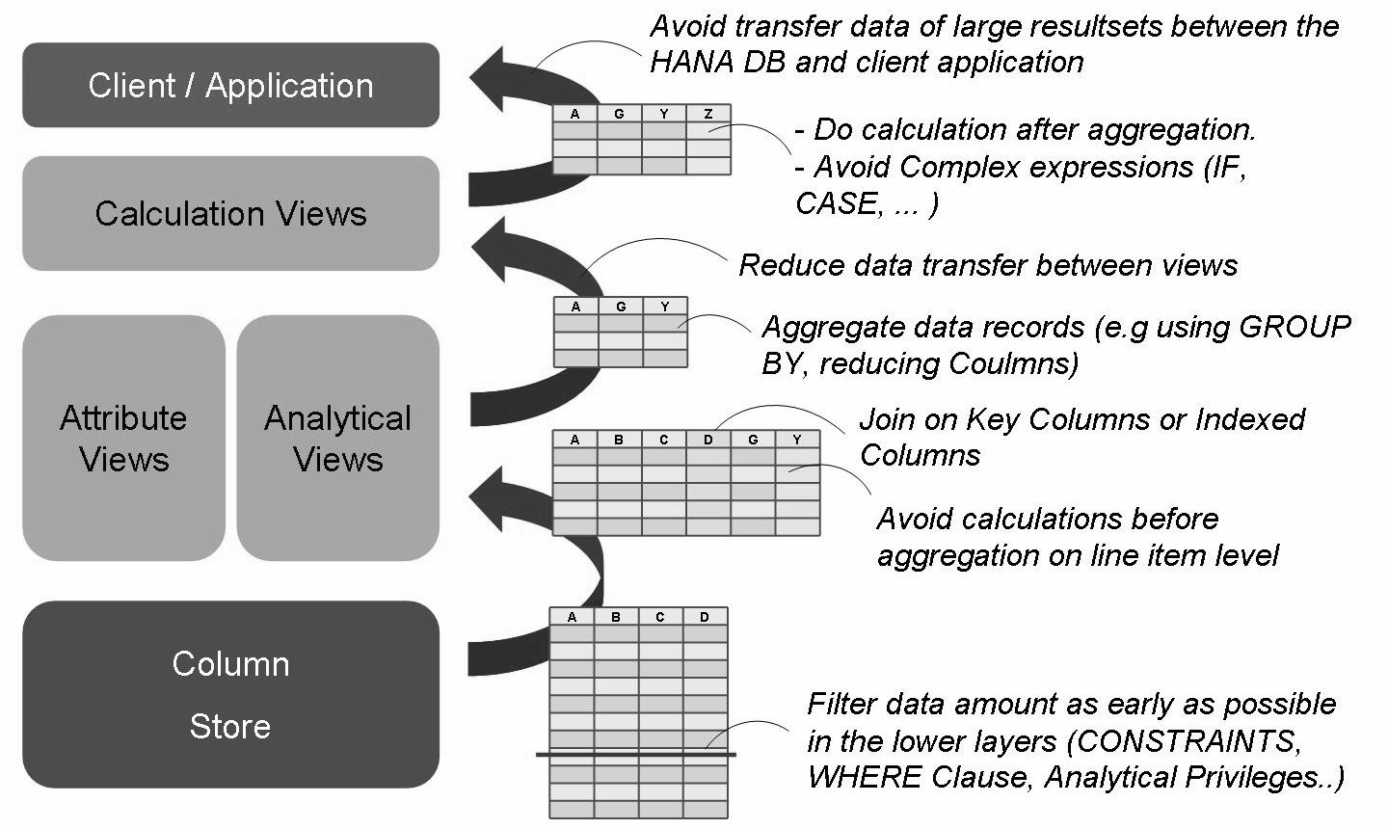
General Modeling Principles

Slide 8
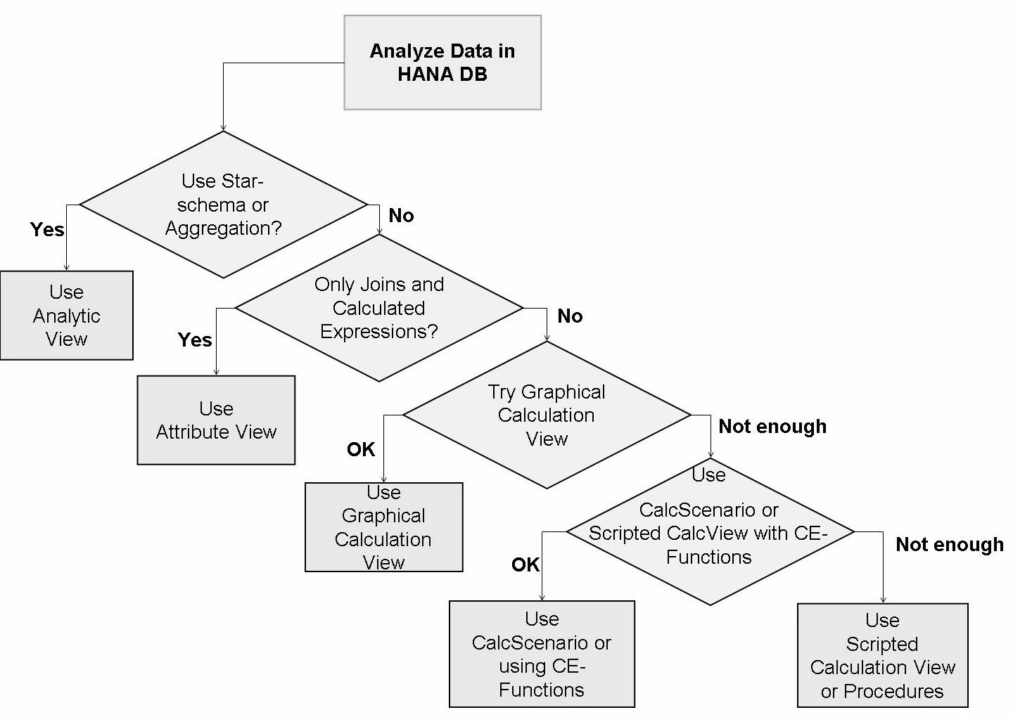
Choosing Views for the Information Model

Slide 9
THANK YOU

